Slide 1
PGE 392K
HW 2 Fall 2020
Grading Rubric
Slide Number | 2 | 3 | 4 | 5 | 6 | 7 | 8 | 9 | 10 | 11 | 12 | 13 | 14 | 15 | 16 | 17 | 18 | 19 | 20 | 21 | Toatal
Points | 2 | 2 | 2 | 2 | 4 | 4 | 4 | 4 | 6 | 5 | 5 | 5 | 5 | 5 | 5 | 8 | 8 | 8 | 8 | 8 | 100
SHADAB, Mohammad Afzal

Slide 2
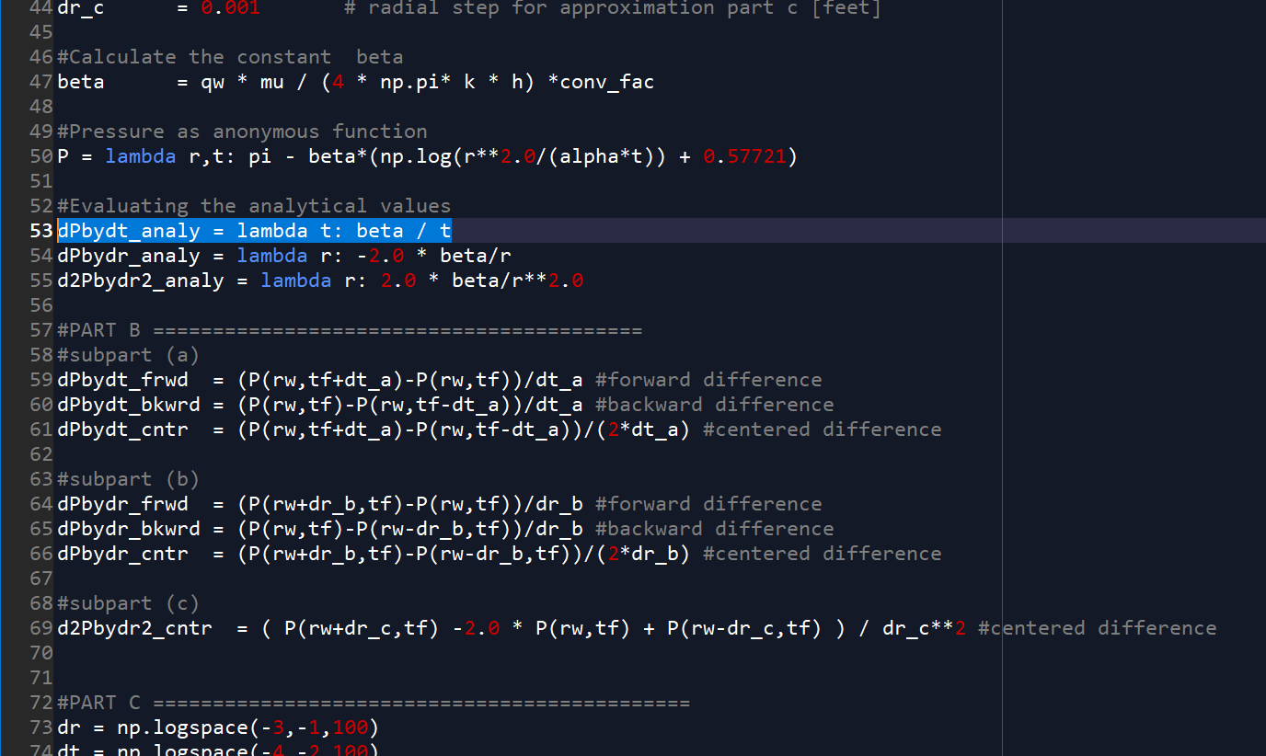
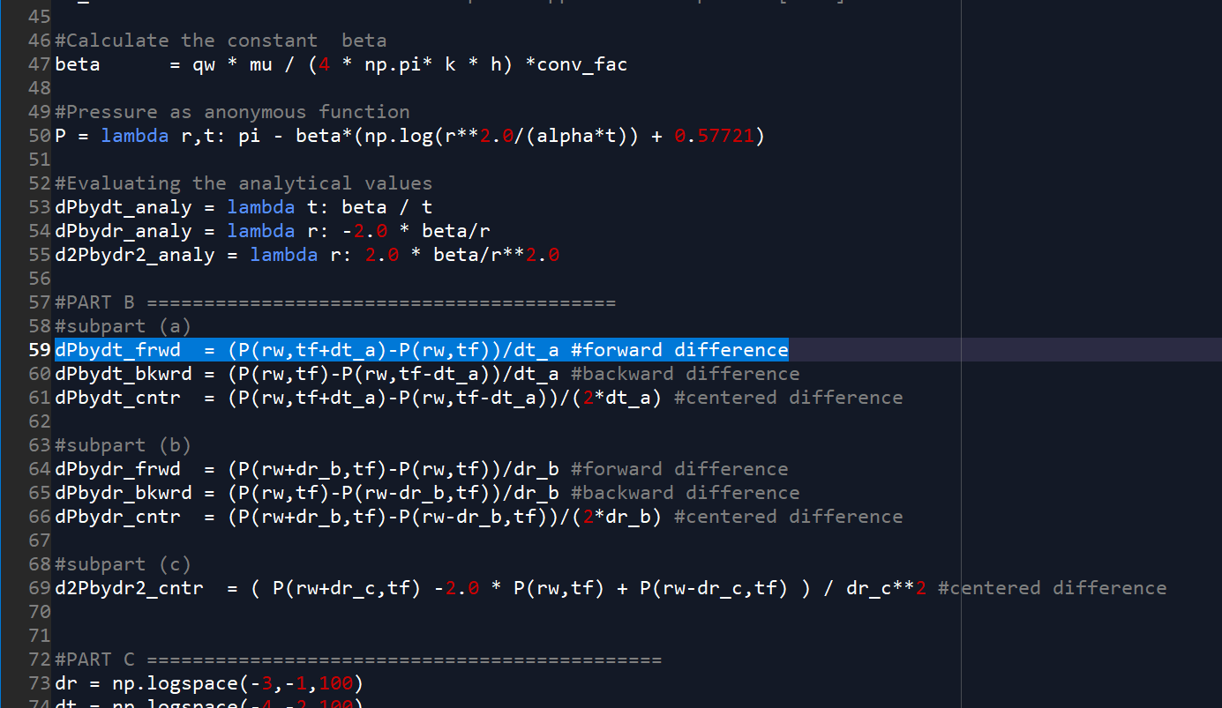
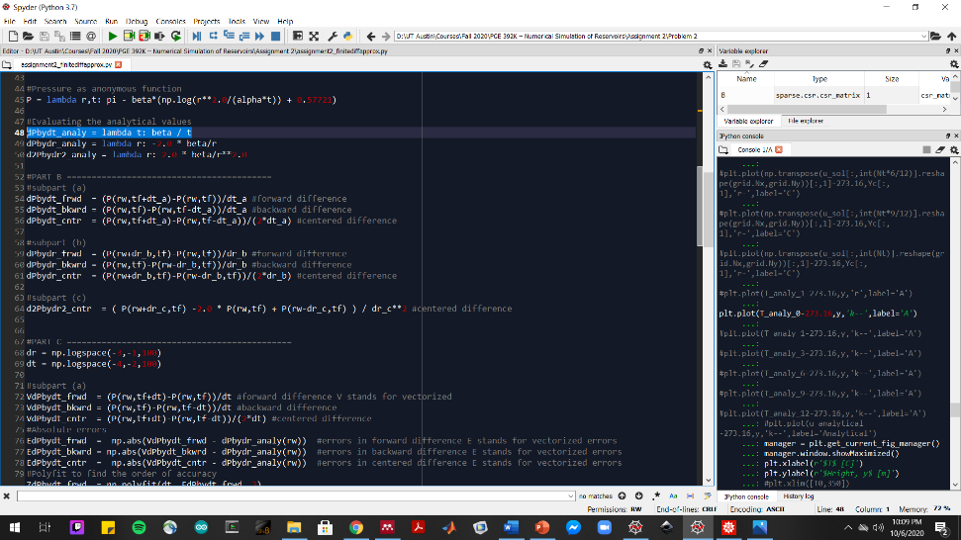
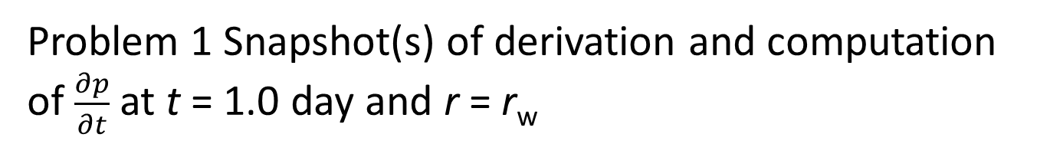
Problem 1 Snapshot(s) of derivation and computation of $\frac{∂p}{∂t}$ at t = 1.0 day and r = r_{w}
1.A.I Analytical
1.B.II.i Numerical Forward

Slide 3
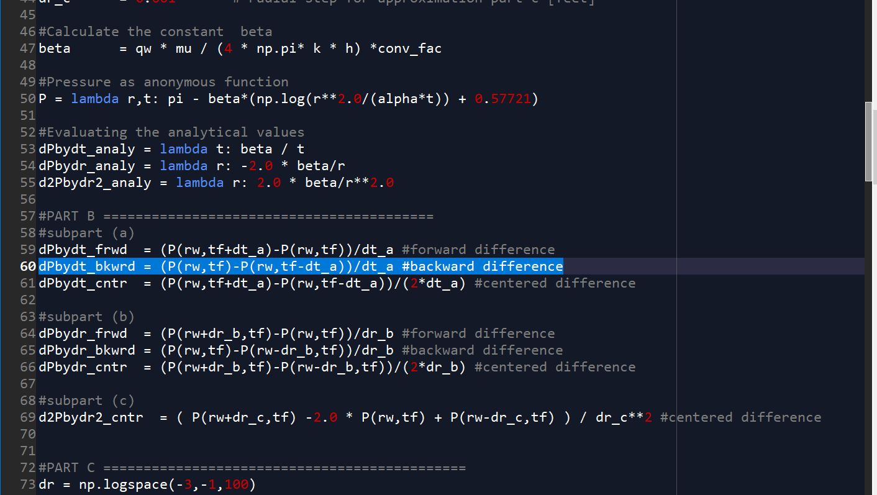
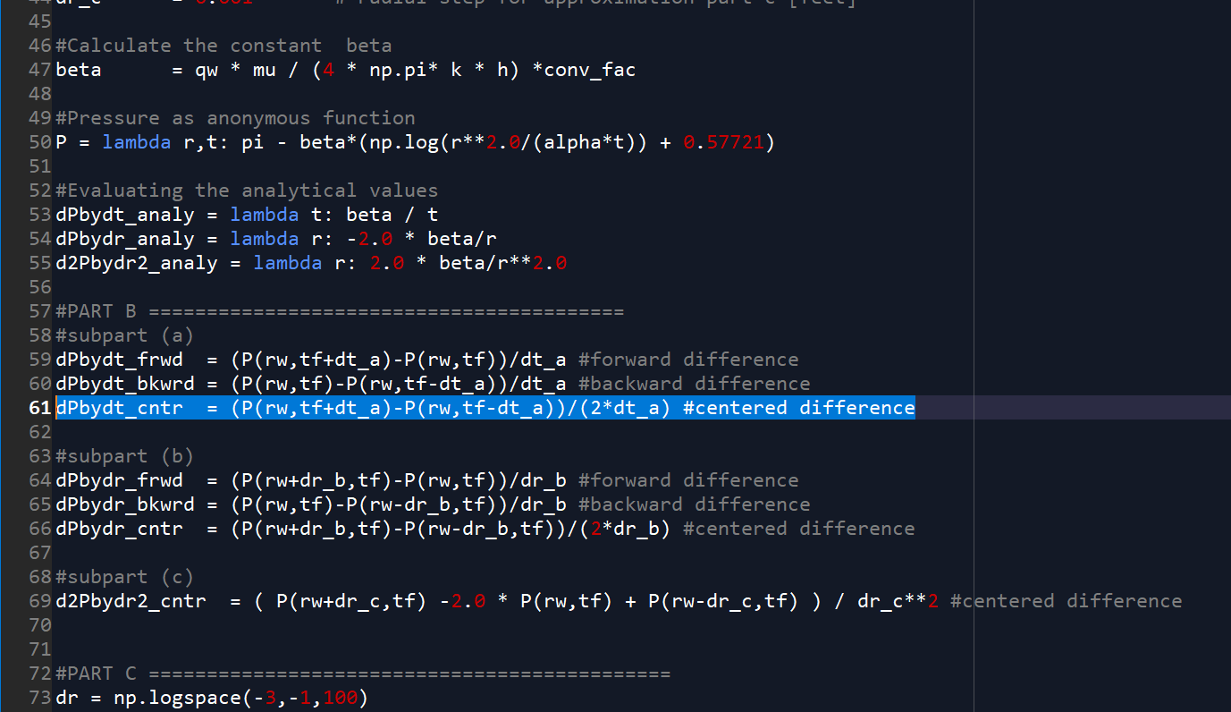
Problem 1 Snapshot(s) of derivation and computation of $\frac{∂p}{∂t}$ at t = 1.0 day and r = r_{w}
1.B.II.ii Numerical Backward
1.B.II.iii Numerical Centered

Slide 4
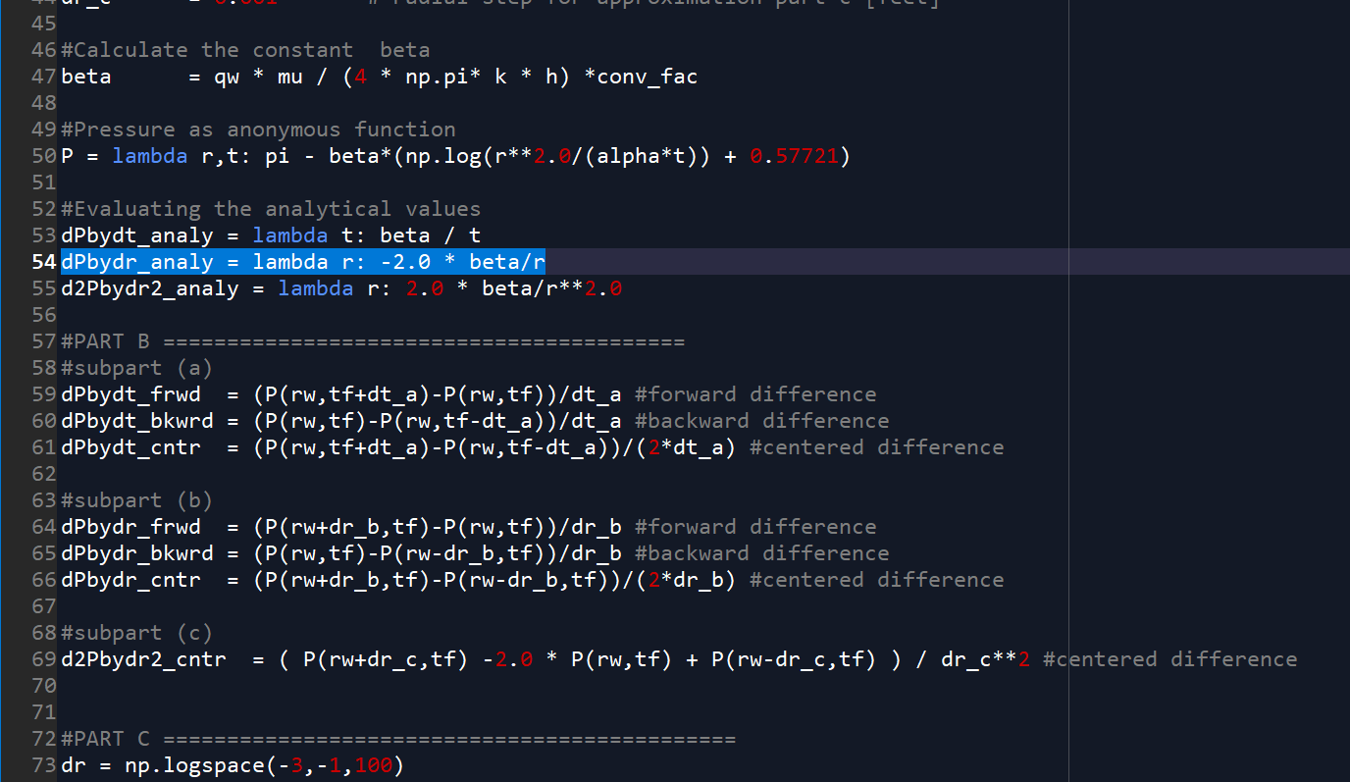
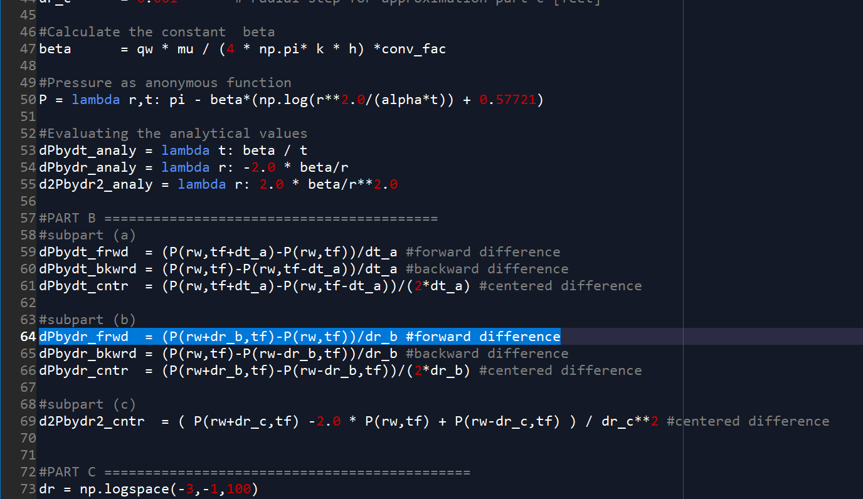
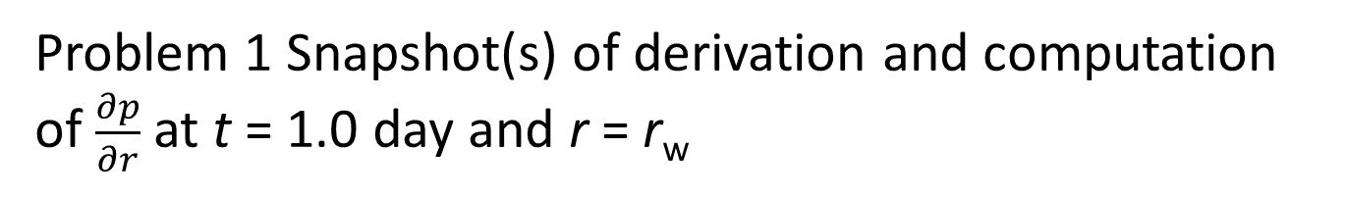
Problem 1 Snapshot(s) of derivation and computation of $\frac{∂p}{∂r}$ at t = 1.0 day and r = r_{w}
1.A.II Analytical
1.B.II.i Numerical Forward

Slide 5
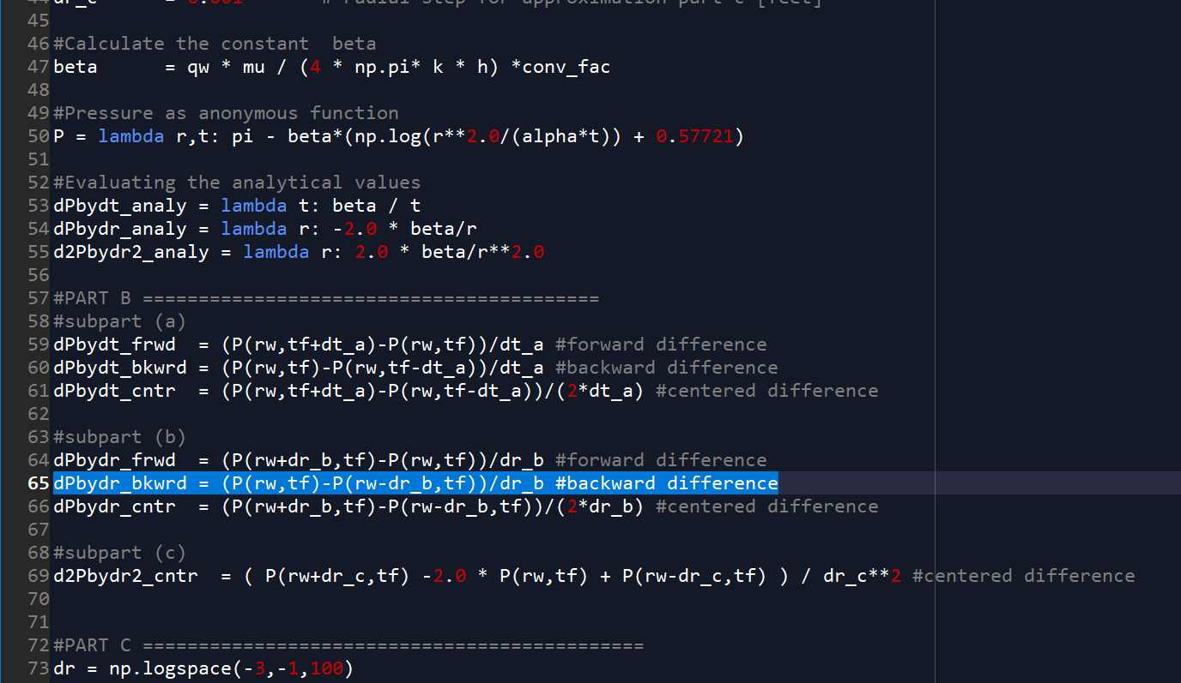
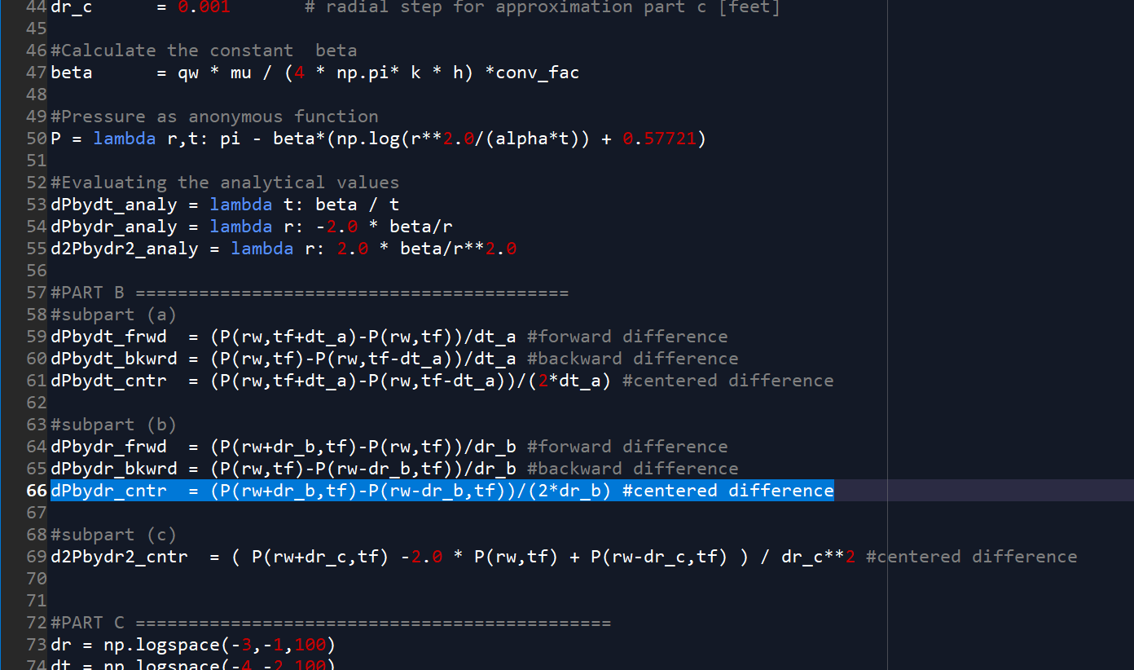
Problem 1 Snapshot(s) of derivation and computation of $\frac{∂p}{∂r}$ at t = 1.0 day and r = r_{w}
1.B.II.ii Numerical Backward
1.B.II.iii Numerical Centered

Slide 6
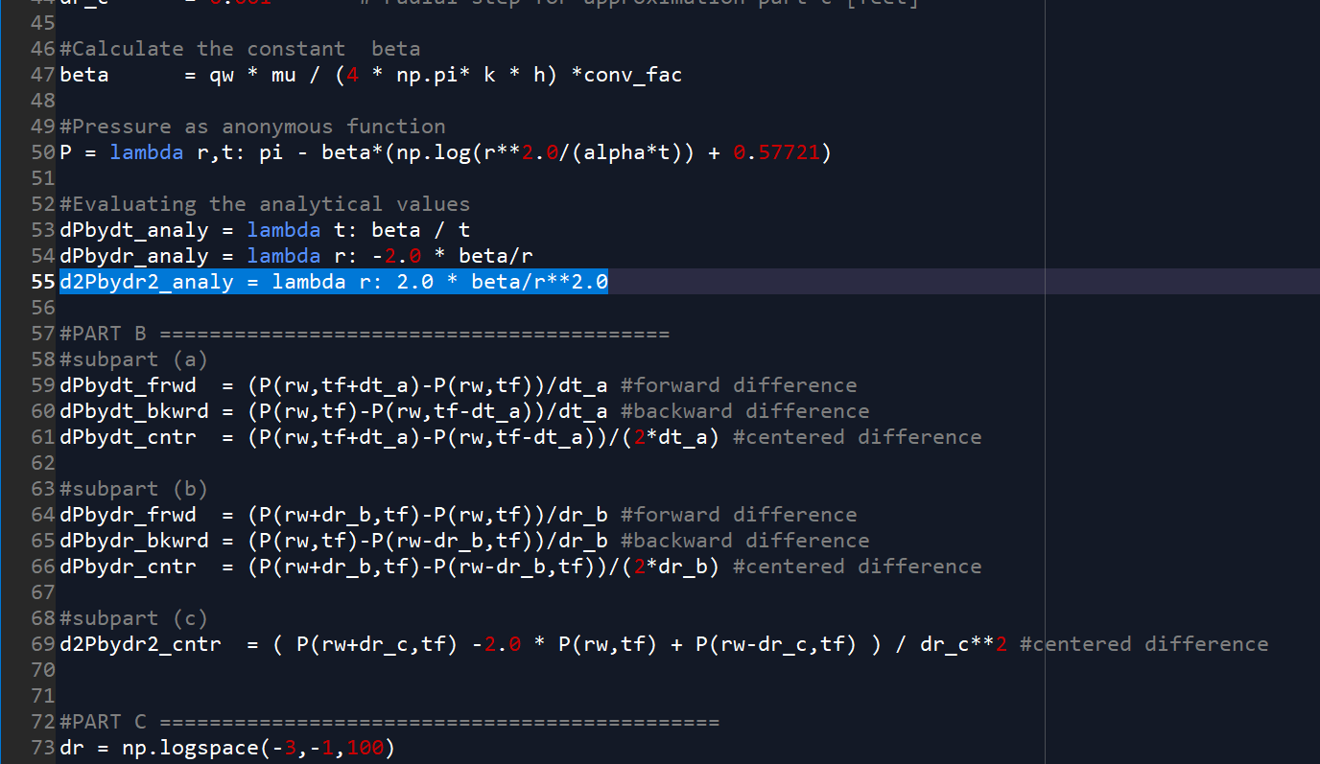
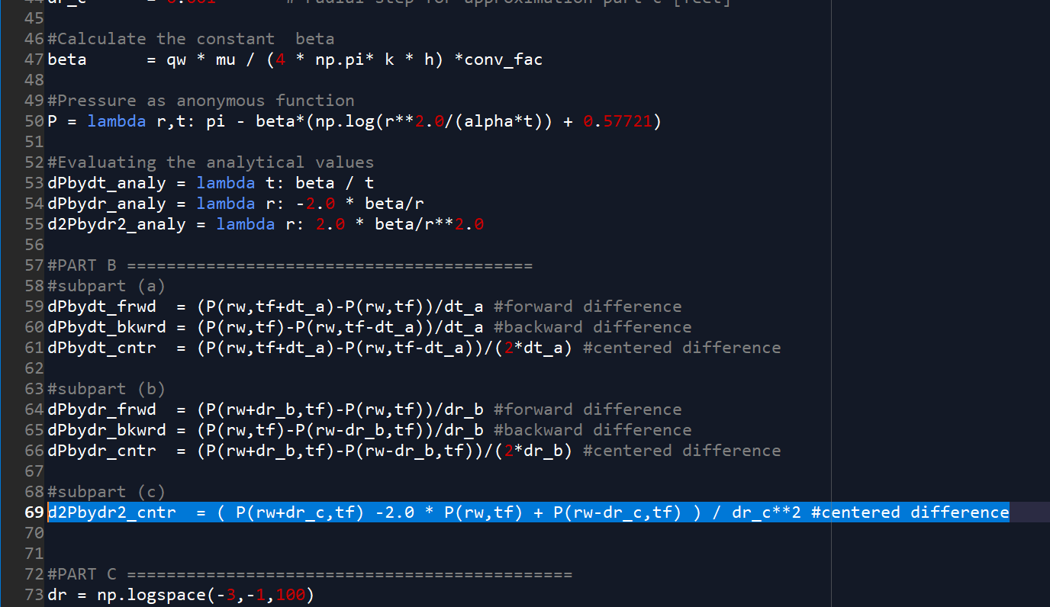
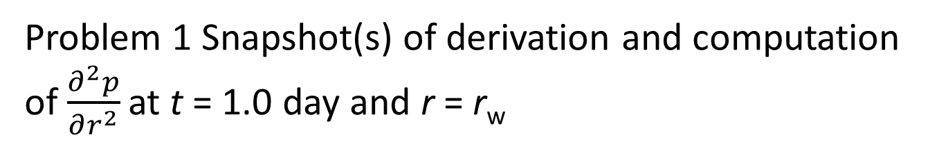
Problem 1 Snapshot(s) of derivation and computation of $\frac{∂^{2}p}{∂r^{2}}$ at t = 1.0 day and r = r_{w}
1.A.III Analytical
1.B.III Numerical Centered

Slide 7
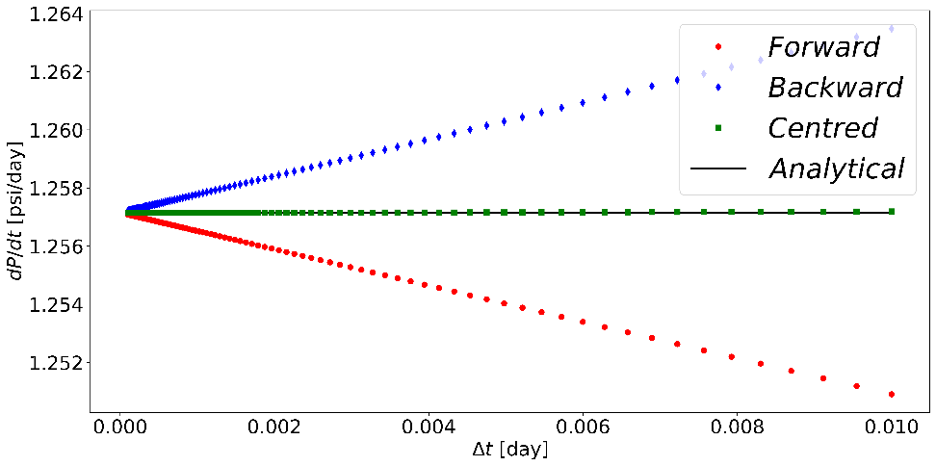
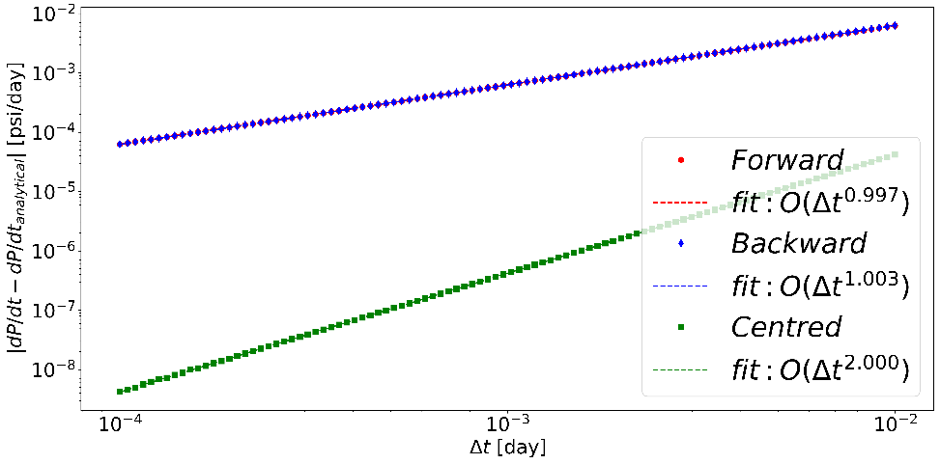
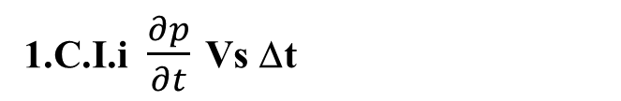
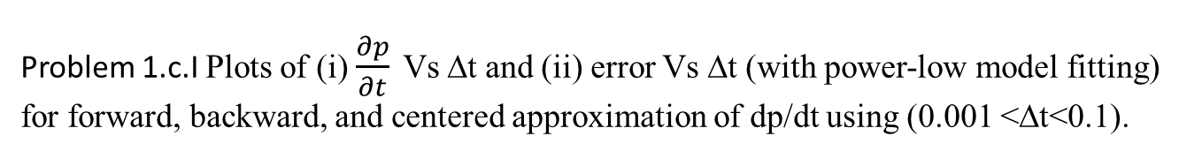
Problem 1.c.I Plots of (i) $\frac{∂p}{∂t}$ Vs Δt and (ii) error Vs Δt (with power-low model fitting) for forward, backward, and centered approximation of dp/dt using (0.001 <Δt<0.1).
1.C.I.i $\frac{∂p}{∂t}$ Vs Δt
1.C.I.ii error Vs Δt

Slide 8
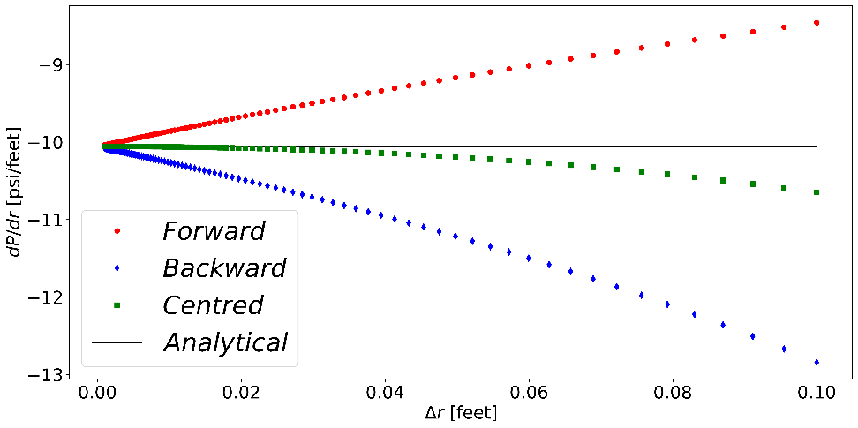
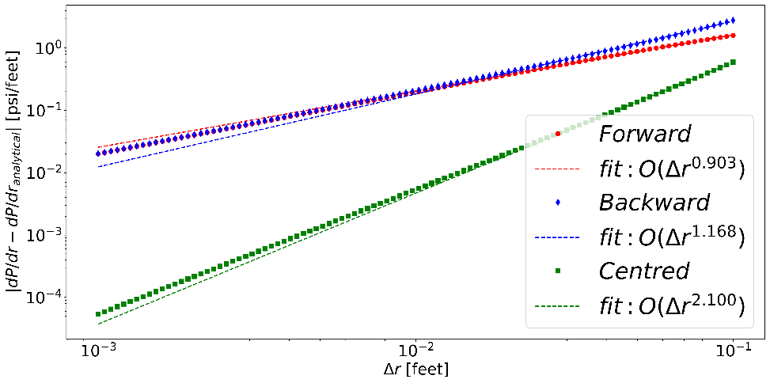
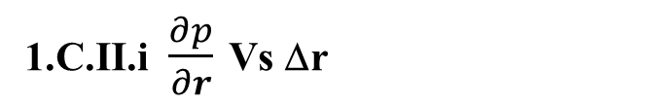
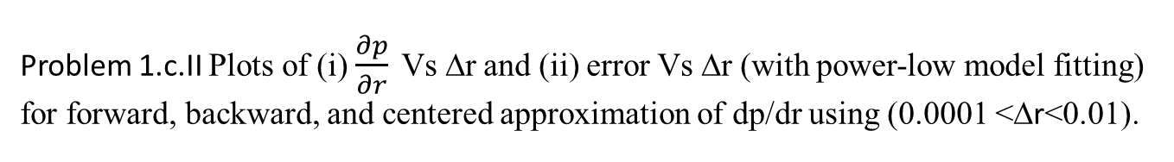
Problem 1.c.II Plots of (i) $\frac{∂p}{∂r}$ Vs Δr and (ii) error Vs Δr (with power-low model fitting) for forward, backward, and centered approximation of dp/dr using (0.0001 <Δr<0.01).
1.C.II.i $\frac{∂p}{∂r}$ Vs Δr
1.C.II.ii error Vs Δr

Slide 9
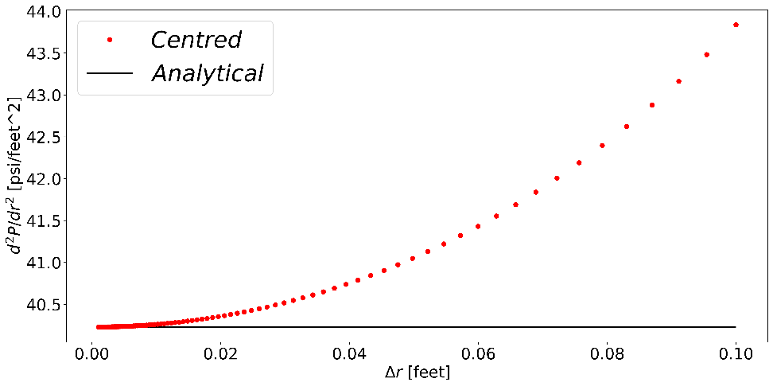
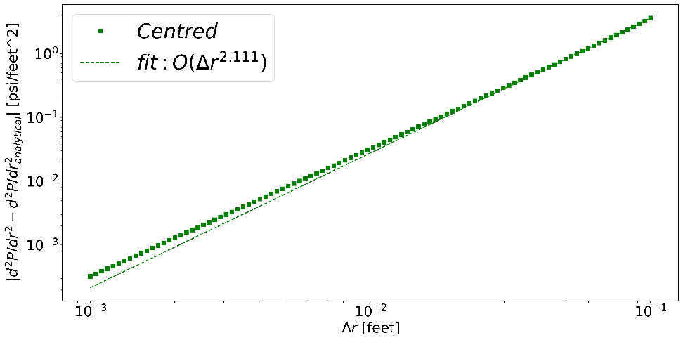
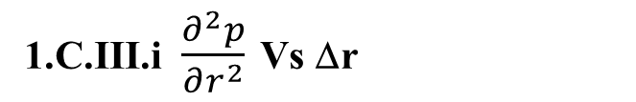
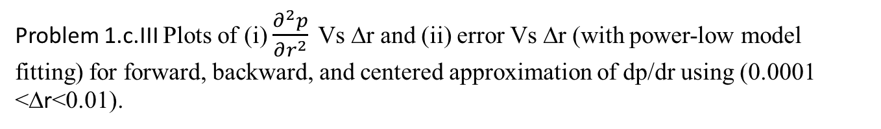
Problem 1.c.III Plots of (i) $\frac{∂^{2}p}{∂r^{2}}$ Vs Δr and (ii) error Vs Δr (with power-low model fitting) for forward, backward, and centered approximation of dp/dr using (0.0001 <Δr<0.01).
1.C.III.i $\frac{∂^{2}p}{∂r^{2}}$ Vs Δr
1.C.III.ii error Vs Δr

Slide 10
Problem 1.C.IV Comments and observations with respect to theory
It is observed that the forward and backward differences are first order and central difference ais second order, which can be mathematically confirmed using truncation error analysis using Taylor expansion
The order is not exact because the theory is valid when ∆t (or ∆x) goes to zero.
We also observe a significant deviation from the predicted order of accuracy at larger ∆t (or ∆x).

Slide 11
Problem 2.a Fill the following table
Time | Method | Block #1 (psia) | Block #2 (psia) | Block #3 (psia) | Block #4 (psia)
1 day | Explicit | 1506.4 | 1000 | 1000 | 1000
 | Implicit | 1295.15 | 1051.10 | 1008.89 | 1001.80
 | C-N | 1370.50 | 1037.82 | 1003.86 | 1000.43
 | Analytical | 1482.3 | 1035.0 | 1000.4 | 1000.0
2 days | Explicit | 1628.14 | 1128.22 | 1000 | 1000
 | Implicit | 1472.49 | 1117.86 | 1026.86 | 1006.86
 | C-N | 1547.79 | 1117.54 | 1018.33 | 1002.83
 | Analytical | 1619.3 | 1136.1 | 1013.0 | 1000.5

Slide 12
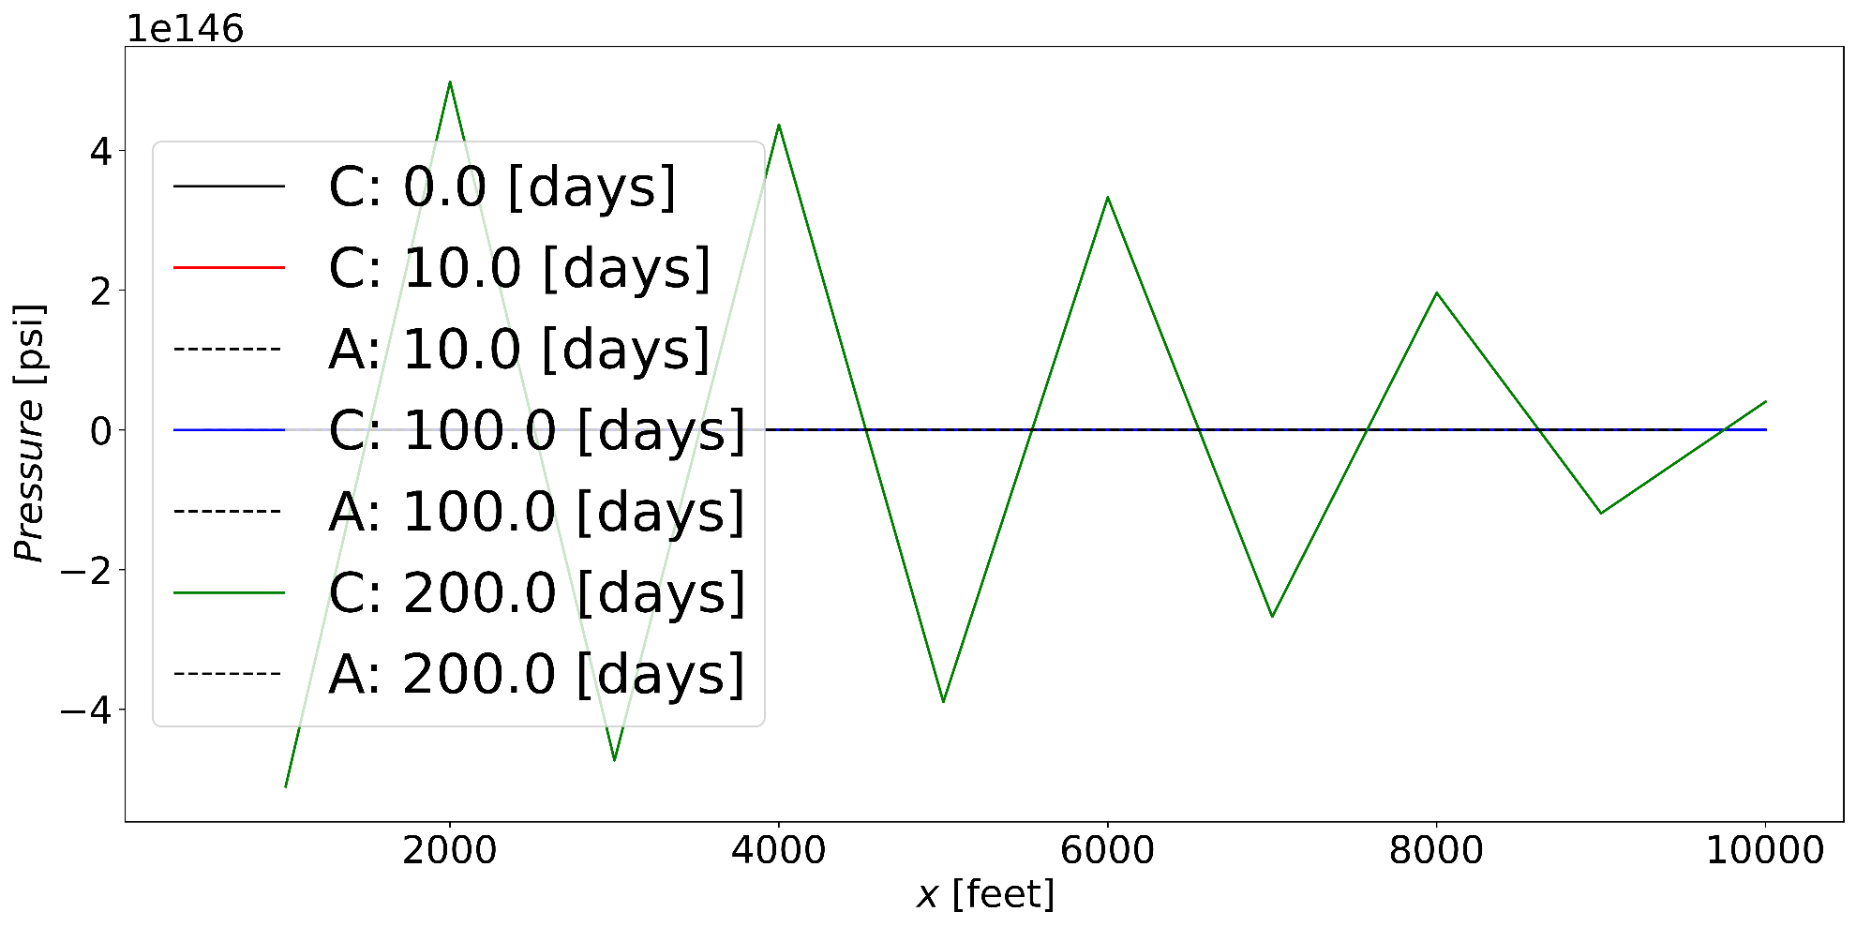
Problem 2.b&c pressure Vs position plot at three times (Analytical and Explicit)
A: Analytical, C: Computed

Slide 13
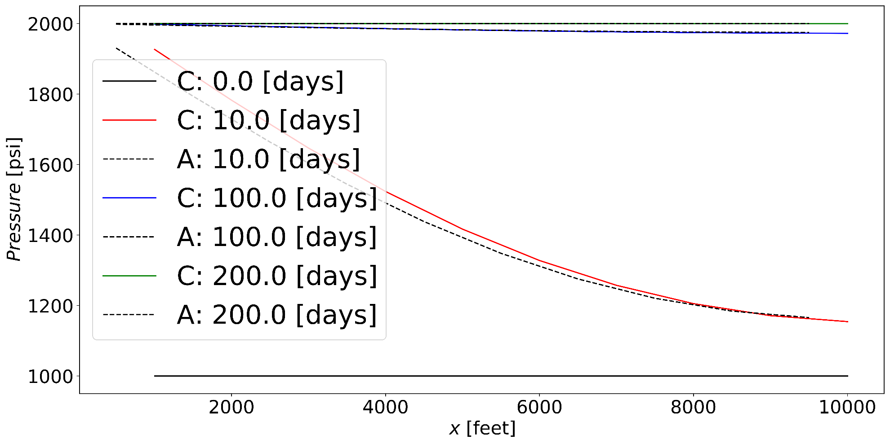
Problem 2.d pressure Vs position plot at three times (Analytical and Implicit)

Slide 14
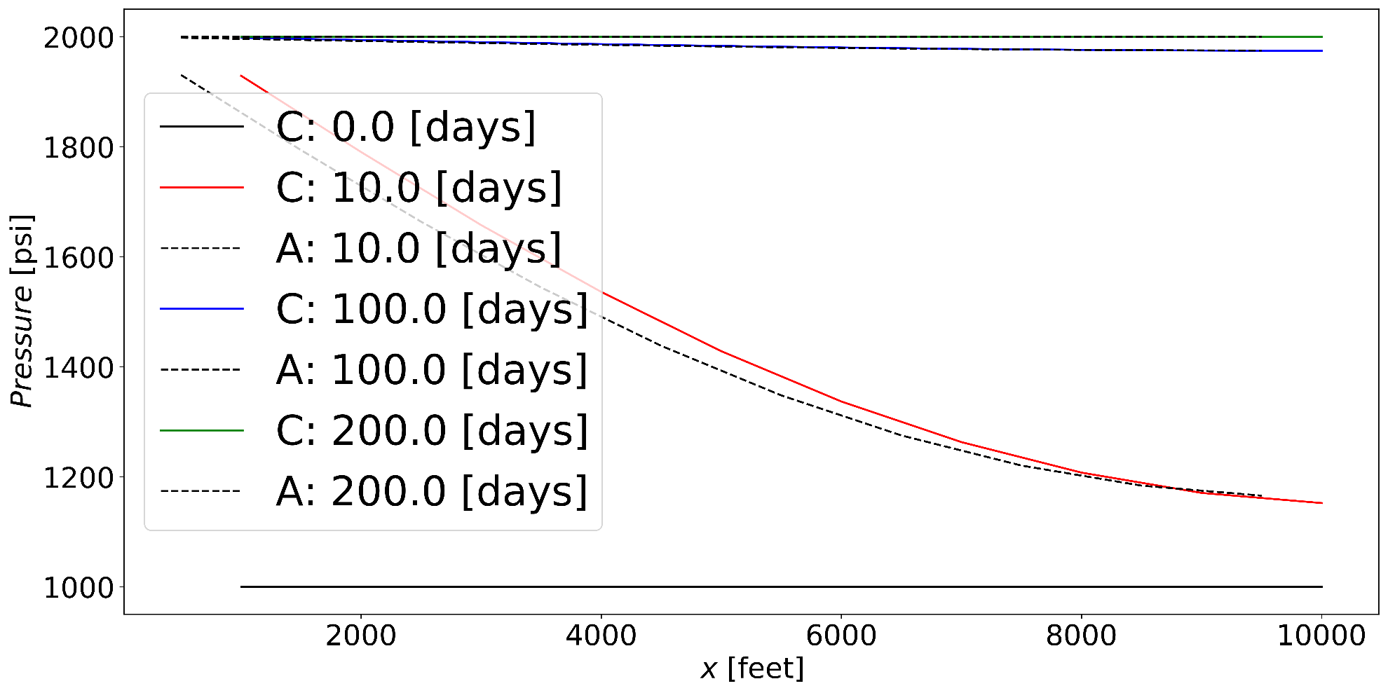
Problem 2.e pressure Vs position plot at three times (Analytical and C-N)

Slide 15
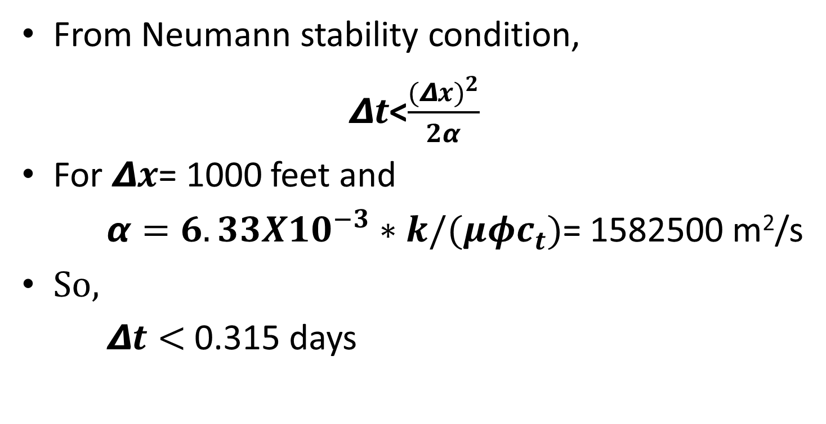
Problem 2.f Written calculation of stability condition
From Neumann stability condition,
$Δt$<$\frac{{(Δx)}^{2}}{2α}$
For $Δx$= 1000 feet and
$α=6.33Χ{10}^{−3}∗k/(μφc_{t})$= 1582500 m²/s
So,
$Δt<$ 0.315 days

Slide 16
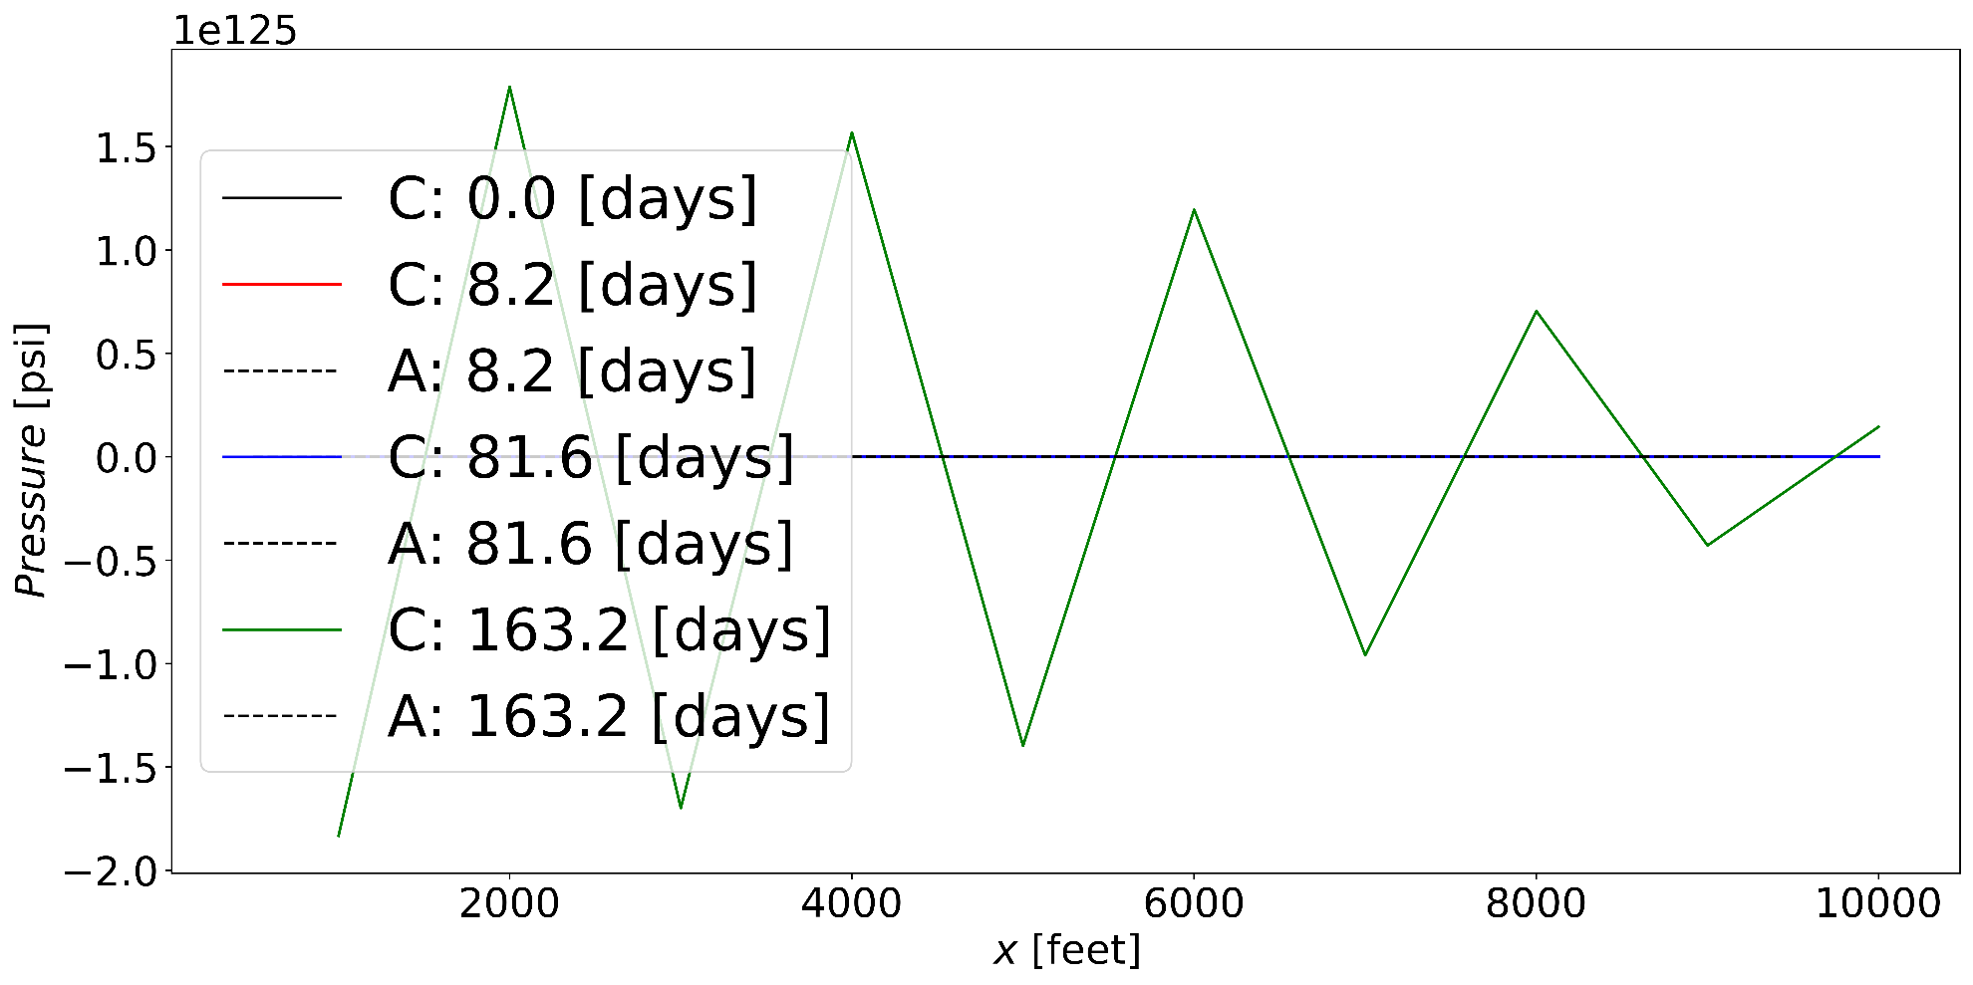
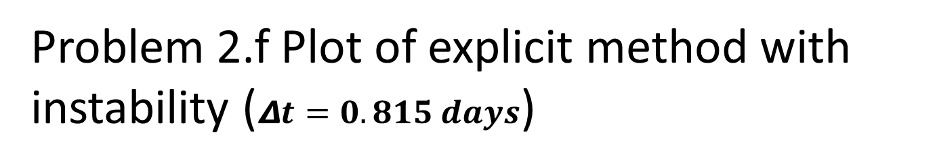
Problem 2.f Plot of explicit method with instability ($Δt=0.815 days$)

Slide 17
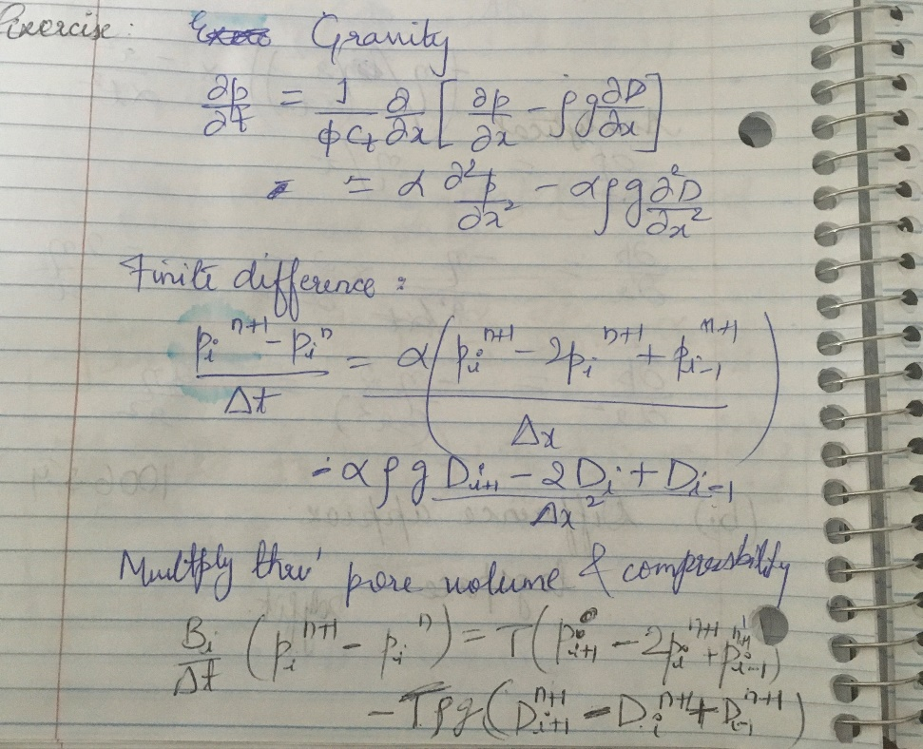
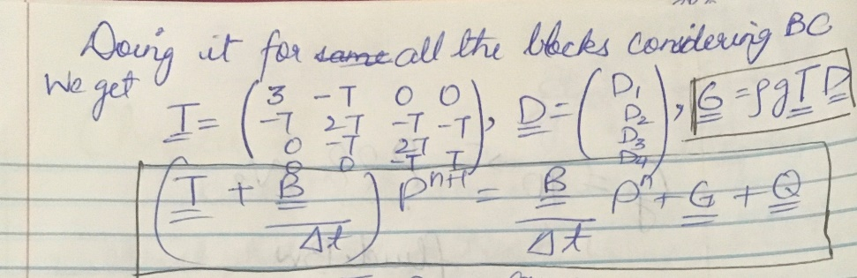
Problem 3.a Snapshot(s) of your derivation of gravity vector G

Slide 18
Problem 3.b Fill the following table
Time | Method | Block #1 (psia) | Block #2 (psia) | Block #3 (psia) | Block #4 (psia)
1 day | Explicit | 1369.14 | 1000 | 1000 | 862.85
 | Implicit | 1214.66 | 1033.87 | 986.85 | 887.90
 | C-N | 1269.94 | 1026.28 | 990.25 | 877.16
 | Analytical
2 days | Explicit | 1457.88 | 1093.47 | 965.27 | 760.42
 | Implicit | 1342.56 | 1074.91 | 969.40 | 794.93
 | C-N | 1398.54 | 1079.18 | 970.06 | 778.57
 | Analytical

Slide 19
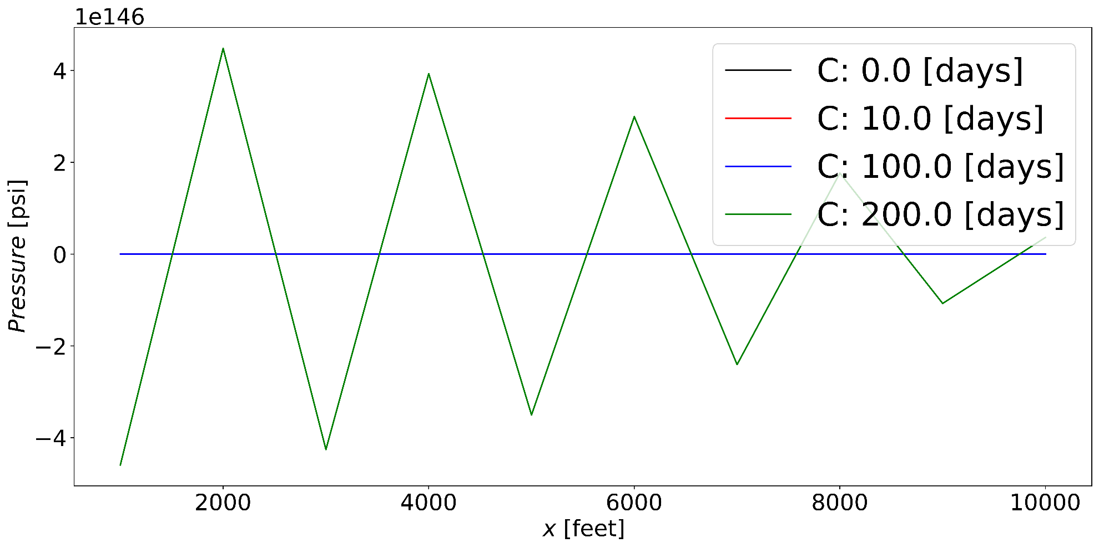
Problem 3.c pressure Vs position plot at three times (Analytical and Explicit)

Slide 20
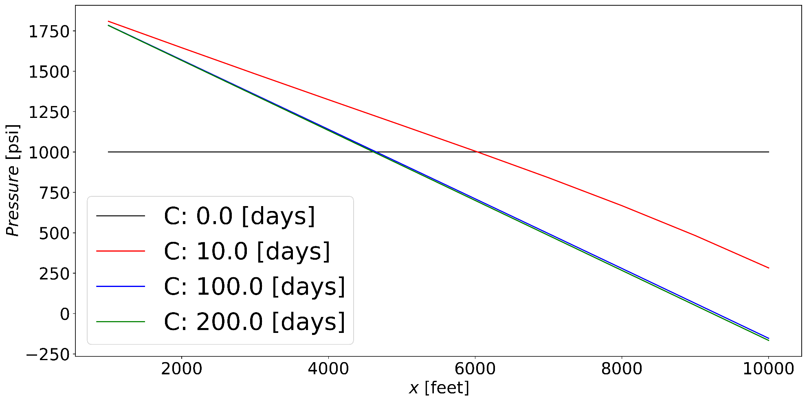
Problem 3.d pressure Vs position plot at three times (Analytical and Implicit)

Slide 21
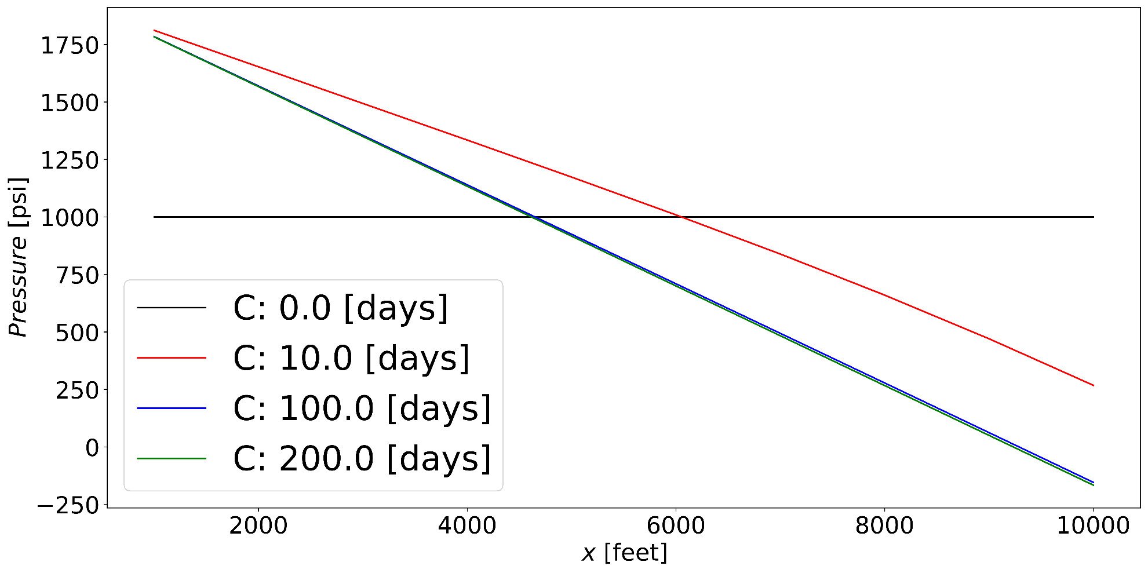
Problem 3.e pressure Vs position plot at three times (Analytical and C-N)

